Slide 1
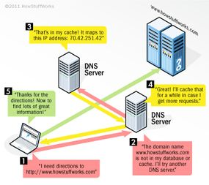

Slide 2
User Requests a Website
You type a domain name (e.g., google.com) in the browser.
The browser checks its cache to see if it already knows the IP address.
DNS Recursive Resolver Checks Cache & Queries Servers
If not found in the browser cache, the request goes to a recursive DNS resolver (provided by your ISP or a third-party like Google DNS).
The resolver first checks its own cache. If the IP is not stored, it starts querying DNS servers.

Slide 3
Querying the DNS Hierarchy
The recursive resolver asks the following servers in order:
Root DNS Server → Directs the resolver to the correct TLD server (e.g., .com, .net).
Top-Level Domain (TLD) Server → Directs the resolver to the domain's authoritative name server.
Authoritative Name Server → Holds the actual IP address for the requested domain and returns it to the resolver.

Slide 4
Returning the IP Address
The recursive resolver receives the IP address from the authoritative server.
It stores the IP in its cache for faster future lookups.
The resolver sends the IP to your browser.

Slide 5
Website Loads via IP Address
The browser now knows the correct IP and sends an HTTP request to the web server.
The web server responds, and the website loads on your screen.

